Slide 1
Information Technology, The Internet And You

Slide 2
Competencies
Explain the five parts of an information system.
Distinguish between system and application software.
Distinguish between system and applections software programs.
Distinguish between basic and specialized application software.
Identify the four types of computers and microcomputers.

Slide 3
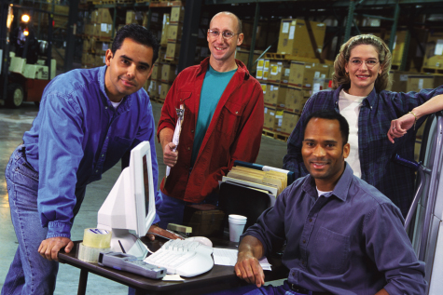
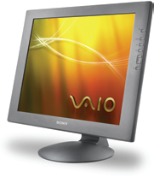
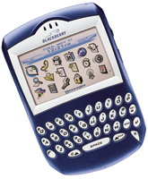
Competencies
Describe the different types of hardware.
Define data and describe files.
Explain connectivity, the wireless revolution, and the Internet.

Slide 4
Parts of an Information System
People: end users and information technology staff
Procedures: the rules or guidelines people follow when using software, hardware, and data
Software: programs that tell the computer how to do its work – they process data to convert it into information
Hardware: the equipment that processes the data to create information
Data: the raw, unprocessed facts including text, numbers, images, and sounds.
Connectivity allows computers to connect and share information

Slide 5
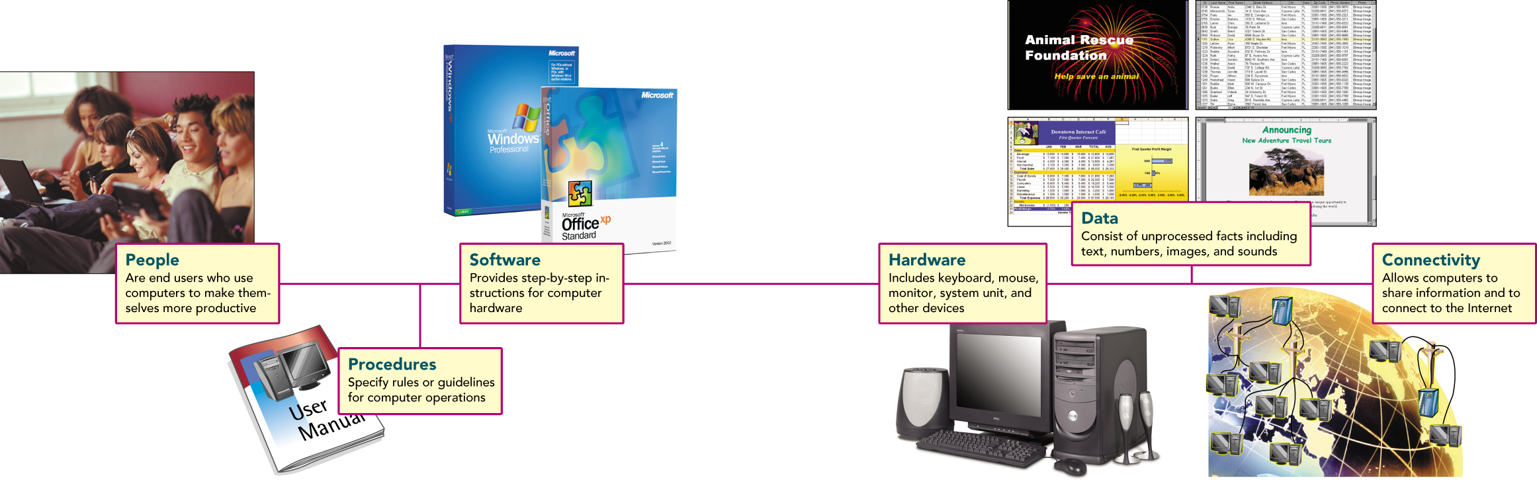

Slide 6
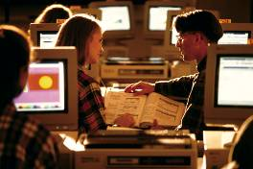
1- People
People are the most important part of any information system.
Contact is …
Direct
Indirect
Computer uses
Business & Entertainment
Education & Medicine

Slide 7
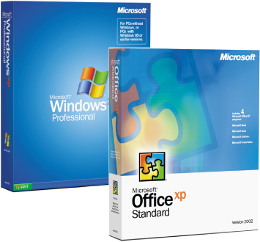
2- Software
Software is another name for programs.
Programs tell the computer how to process data.
Two major kinds of software
System Software.
Application Software.

Slide 8
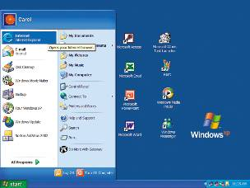
1. System Software
A collection of programs.
Enables the application software to interact with the hardware.
Background software that helps the computer manage its own resources.

Slide 9
Cont…
Operating Systems: Programs that coordinate computer resources, provide an interface between the user and computer, and run applications.
Examples include Windows XP and the Mac OS X
Utilities (service programs): Perform specific tasks related to managing computer resources, such as de-fragmenting disks, checking for viruses, etc.
Device Drivers: Specialized programs to allow particular input and output devices to communicate with the rest of the system, for example, a printer driver.

Slide 10
2. Application Software
Application software is “end user” software.
Basic or General-purpose applications
Examples include:
Browsers: to search the Internet and Web
Word Processors: to create and edit documents
Spreadsheets: to analyze and summarize numerical data
Database Management Systems (DBMS): organize and manage data and information
Presentation Graphics: communicate a message
Special-purpose applications
Include thousands of applications that are narrowly focused on a specific profession or occupation.
Some of the best known are graphics, audio and video, multimedia, web authoring, and artificial intelligence programs.

Slide 11
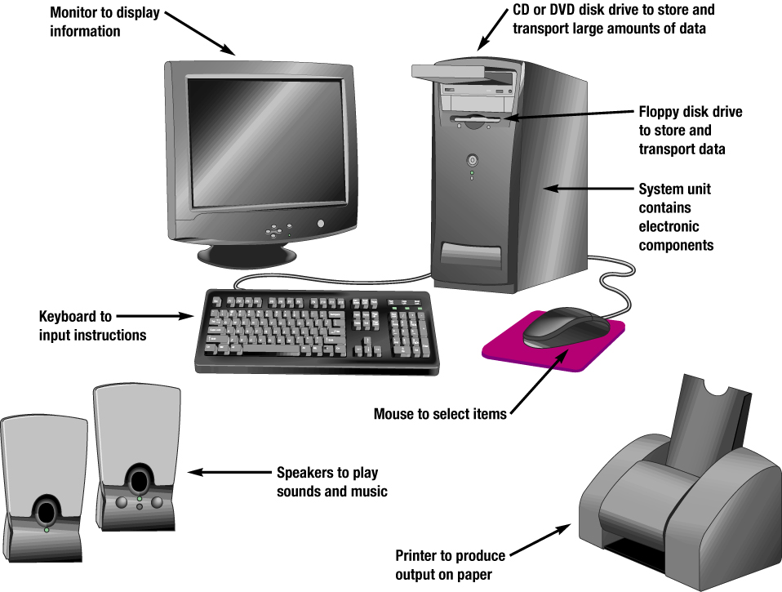
3- Hardware
Equipment that processes the data
Controlled by software
Physical devices
Keyboard
Mouse
Monitor
Other devices

Slide 12
3- Hardware ….
Type of Computer:
Supercomputers: The most powerful type of computers
Example: NASA uses supercomputers to track and control space explorations.
Mainframe Computer: Not quite as powerful as supercomputers, they still have great processing speeds and storage capacity.
Often fill up a specially wired and air-conditioned room.
Typically used for business applications such as insurance companies that process thousands of policy holder billing statements.

Slide 13
Type of Computer (cont) ….
Minicomputers: Also known as midrange computers
Work like a “small” mainframe
Typically the size of a refrigerator
A production department may use a minicomputer to monitor manufacturing processes and assembly line operations.
Microcomputer: The least powerful, but most widely used computers.
There are four main types of microcomputers:
Desktop.
Notebook or laptop.
Tablet PC.
Handheld.

Slide 14
Microcomputer Types :-
Desktops: small enough to fit on top or along side your desk, yet too big to carry around
Notebooks (or laptops): portable, lightweight, fit in most briefcases
Tablet PCs: type of notebook that accepts your handwriting on a specially designed input screen
Handheld computers (or palm computers, Personal Digital Assistants – PDAs): the smallest microcomputers, typically combine pen input, handwriting recognition, personal organizational tools, and communications capabilities in a very small package.

Slide 15
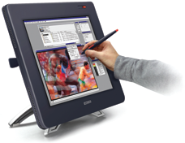

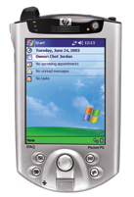
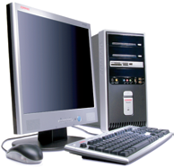
Microcomputer types
Notebook
Desktop
Handheld
Tablet PC

Slide 16
Microcomputer Hardware
System unit: Also known as the system cabinet or chassis
Holds most of the electronic components that make up the computer, including:
Microprocessor (aka processor, Central Processing Unit – CPU):
Memory (aka primary storage, Random Access Memory – RAM)
Input/output devices: Input device such as keyboard and mouse.
Output device such as Monitor and printer.
Secondary storage:
Communications: Used to connect and share information from one computer to another.
A Modem is a popular communication device used to connect a computer to another using ordinary phone lines.

Slide 17
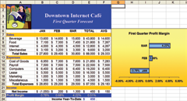
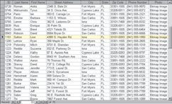


4- Data
Raw, unprocessed facts
Processing creates information
Stored electronically in files
Document files
Worksheet files
Database files
Presentation files
← Presentation
← Database
← Worksheet
← Document
Notes:
Used to describe facts about something
Contained in files for documents, worksheets, and databases
Document files - usually created by word processors
Worksheet files - electronic spreadsheets
Database files - electronic database management programs
Presentation files - electronic slide shows

Slide 18
A. Document Files
Created by word processors to save documents such as memos, term papers, and letters
Notes:
Word processors are used to prepare written documents
Create text-based documents
One of the most flexible and widely used software tools
Features to make entering, editing, and formatting documents easy

Slide 19
B. Worksheet Files
Created by electronic spreadsheets to analyze things like budgets and to predict sales
Notes:
Files created by spreadsheet programs
Uses functions and formulas to analyze numeric data
Manipulates numeric data
Features include workbooks, worksheets, cells, ranges, text and numeric entries, formulas, functions, charts, recalculation, and what-if analysis

Slide 20

C. Database Files
Typically created by database management programs to contain highly structured and organized data
Notes:
A database management system (DBMS) or database manager is a program that sets up, or structures, a database
Files created by database management programs
Organizes data for efficient retrieval
Is the electronic equivalent of a file cabinet
It also provides tools to enter, edit, and retrieve data from the database

Slide 21
D. Presentation Files
Created by presentation graphics programs to save presentation materials. For example, a file might contain audience handouts, speaker notes, and electronic slides.
Notes:
Used to create a variety of visual objects to create attractive, visually interesting presentations
Features include slides, AutoContent wizard, color schemes, slide layouts, special effects, master slides, and design templates
Presentation files may contain audience handouts, speaker notes, and electronic slides

Slide 22

5- Connectivity, the Wireless Revolution, and the Internet
Connectivity
Sharing of information
Wireless communication is becoming popular
Computer networks
Connected communication system of computers
Largest network is the Internet
Notes:
Connectivity is the capability of your microcomputer to share information with other computers
Wireless /mobile communication devices are more popular than ever
A network is central to the concept of connectivity
Ask students questions about the Internet. Here are some facts:
No one owns the Internet
There is no Internet, Inc.
The Internet is a network of networks
The Word Wide Web (WWW) provides multimedia interface to resources on the Internet

Slide 23

Knowledge Foundation
Being Computer Competent means using and understanding Information Technology (IT)
Notes:
Using information technology means being computer competent
Understand how technology is being used today
Anticipate how technology will be used in the future

Slide 24

Some Important IT Developments
The Internet & the Web
Powerful software & hardware
Privacy & security
Organizations
Changing Times
Notes:
The Internet and the Web are the two most important technologies of the 21st century
Software can now do extraordinary tasks
Microcomputers are more powerful
Society must be careful about protecting their privacy
Almost all organizations rely on information systems

